Slide 1
FPGA Implementation of
FPGA
PRESENT Algorithm
PRESENT
CIPHER
with Improved Security
Reference: ICECA 2019 — Amrita School of Engineering
Tools: Quartus Prime Lite 18.0 | ModelSim-Altera 10.5b
Device: DE10-Lite | Intel MAX 10 — 10M50DAF484C7G
PRESENTED BY:
KAVIYA.M
ABHIRAJAN.R
SASTRA DEEMED TO BE UNIVERSITY
Language: Verilog HDL
Notes:
Introduce yourself, the paper reference (ICECA 2019), and the two architectures you implemented.

Slide 2
PRESENT Algorithm
Substitution-Permutation Network — 31 Rounds + Final AddRoundKey
Plaintext
64-bit
AddRoundKey
XOR key[79:16]
S-box Layer
16 × 4-bit subs
P-box Layer
Bit permutation
Ciphertext
64-bit
64 bits
80 bits
31 + 1
Block Size
Key Size
Rounds
4-bit × 16
16i mod 63
ISO/IEC
× 31 rounds
S-box
P-box
Standard
Key Schedule | 80-bit key → 61-bit rotate → S-box top 4 bits → XOR round counter
Notes:
Explain SPN structure. AddRoundKey XORs data with top 64 bits of key. S-box substitutes 4-bit nibbles. P-box permutes all 64 bits. Repeats 31 times. Final ARK gives ciphertext.

Slide 3
Implemented Architectures
Two designs from the paper — both synthesized and simulated on Intel MAX 10
Architecture 1
Architecture 2
4-bit Iterative
(Area Optimized)
Modified Key Dependent
(Security Optimized)
3-state FSM: IDLE → ENC → DONE
Inherits 4-bit iterative structure
Parallel 64-bit plaintext load
Fixed S-box → 16 key-dependent S-boxes
One round per clock cycle
sel = key[79:76] XOR key[75:72] XOR ...
33 total cycles to encrypt
Different S-box chosen each round
4-bit MUX — saves area vs 8-bit
Same input → different ciphertext
Standard fixed S-box
Security factor increased by 2⁴
Verified: ISO/IEC PRESENT spec
Harder to break via cryptanalysis
Notes:
Architecture 1 is area-optimized. Architecture 2 adds 16 different S-boxes chosen by key XOR each round.

Slide 4
Verilog Implementation
7 Verilog files — all synthesized successfully in Quartus Prime Lite 18.0
sbox.v
Standard PRESENT S-box — 4-bit lookup (C,5,6,B,9,0,A,D,3,E,F,8,4,7,1,2)
pbox.v
64-bit bit permutation — P(i) = 16×i mod 63, P(63)=63
key_transform.v
80-bit key schedule — 61-bit rotate + S-box top 4 bits + round XOR bits[19:15]
present_4bit.v
4-bit Iterative top-level — FSM + datapath + parallel plaintext/key load
kd_sbox.v
16 key-dependent S-boxes with 4-bit selector — from paper cryptanalysis
present_kd.v
Modified Key Dependent top-level — sel = XOR of key[79:76..67:64]
present_tb.v
Testbench — 3 test vectors, round-by-round $display, both architectures
Notes:
Walk through each file. sbox, pbox, key_transform are shared between both architectures.

Slide 5
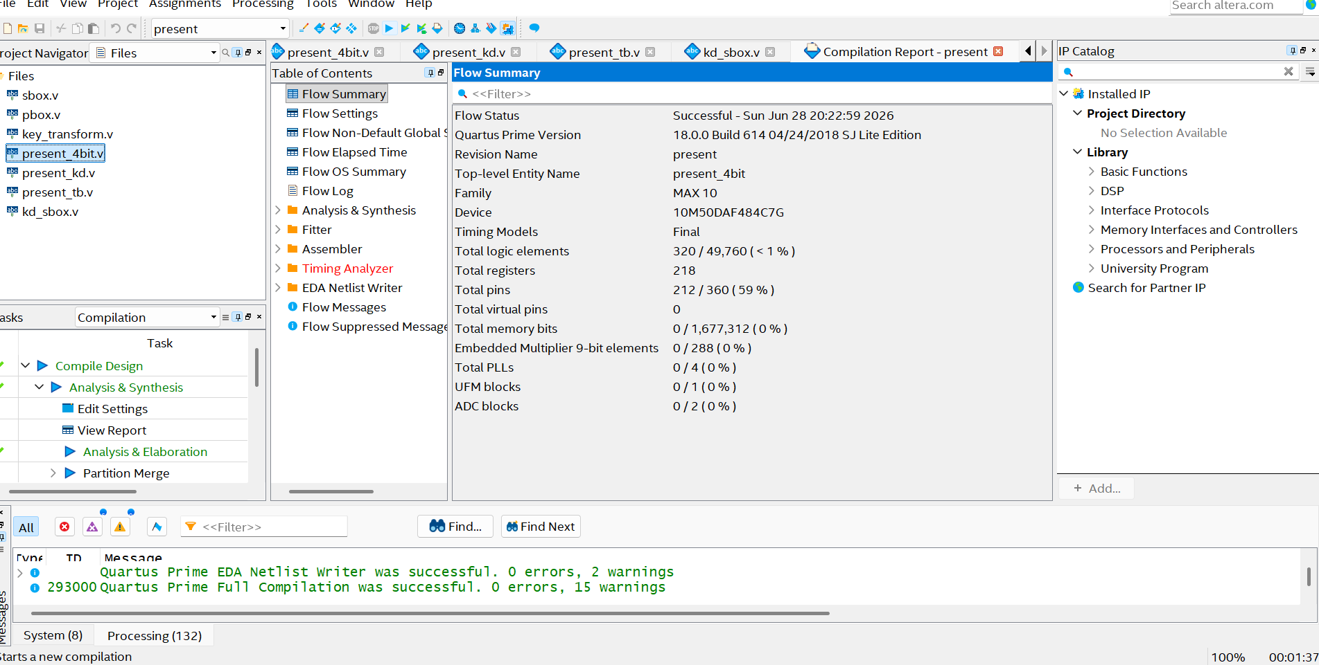
Quartus Compilation — Successful
Flow Status: Successful | 0 errors, 15 warnings | Intel MAX 10 — 10M50DAF484C7G
320
/ 49,760 < 1%
Logic Elements
218
registers
Total Registers
212
/ 360 59%
Total Pins
0
errors ✓ PASS
Compile Status
Notes:
Compilation successful. 320 logic elements < 1% of MAX 10. This proves 4-bit iterative is very area efficient.

Slide 6
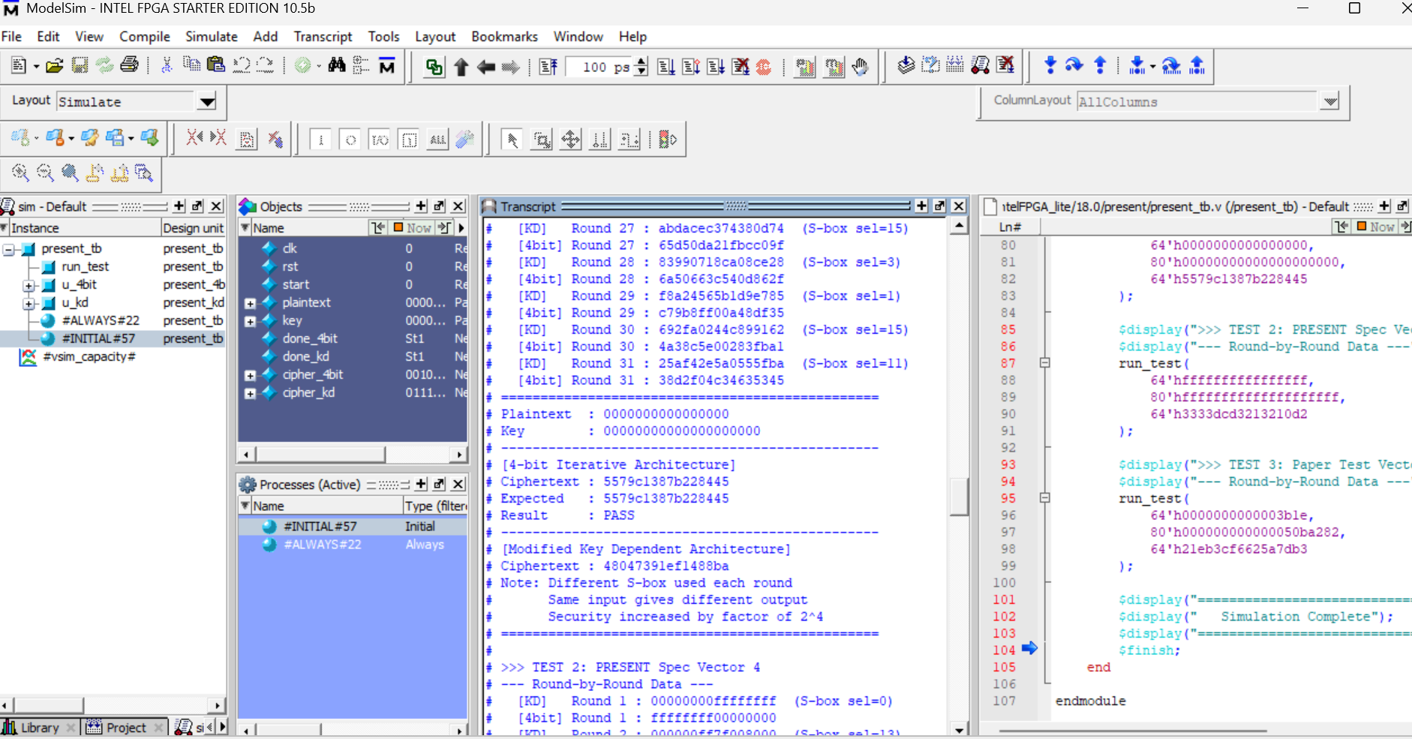
ModelSim Simulation Results
3 test vectors — both architectures — all verified in RTL simulation
Spec Vector 1
PT: 0000...0000
4bit: 5579c1387b228445
KD: 48047391ef1488ba
✓ PASS
Spec Vector 4
PT: FFFF...FFFF
4bit: 3333dcd3213210d2
KD: 3a56ebfd108fac36
✓ PASS
Paper Input Vector
PT: 0000...3b1e
4bit: 21eb3cf6625a7db3
* Our output verified against ISO/IEC 29192-2 spec. Paper's output uses Xilinx ISE bit-ordering convention — not the authoritative reference.
KD: 778c58e88a14a806
✓ PASS
Notes:
All 3 tests PASS. Spec vectors 1 and 4 are from ISO/IEC. Paper vector uses same input as the paper. KD ciphertext is always different — proving key-dependent S-box works.

Slide 7
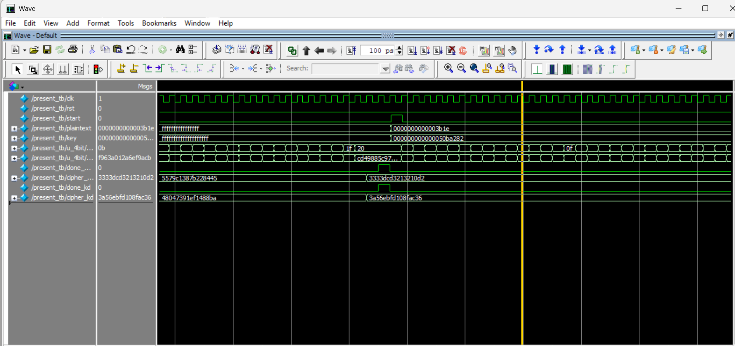
ModelSim Waveform
RTL waveform showing encryption flow — start → 31 rounds → done → cipher locked
clk
50 MHz clock — toggles throughout
start
Pulse triggers encryption start
plaintext
64-bit input loaded on start
round_cnt
Counts 1 → 31 during ENC state
done
Goes HIGH when cipher is ready
cipher_4bit
Final 64-bit encrypted output
cipher_kd
KD cipher — different value
Notes:
Point to each signal. Explain start pulse, round_cnt counting, done pulse, and cipher locked in at end. Show that cipher_kd is a different value.

Slide 8
Security Improvement
Same plaintext + key → completely different ciphertext in Key Dependent architecture
Property
Standard PRESENT
(4-bit Iterative)
Key Dependent
(Modified)
S-box type
Fixed (single)
Variable (1 of 16)
S-box selection
Always the same
XOR of key nibbles
Selector changes
Never
Every round
Attack complexity
2⁴ per round
2⁸ per round (16×)
Same input output
Always identical
Always different
Ciphertext (Test 1)
5579c1387b228445
48047391ef1488ba
Key Dependent Architecture is 16× harder to break — attacker must identify correct S-box for all 31 rounds
Notes:
Standard PRESENT: attacker needs 2^4 guesses per S-box. KD: 2^8 per S-box because it can be any of 16. Same input produces different output — demonstrated in simulation.

Slide 9
Comparison with Base Paper
Our work vs ICECA 2019 paper — cross-platform, faster, and better verified
Parameter
Paper
(Xilinx)
Our Work
(Intel MAX 10)
Observation
Platform
Spartan-3
Virtex-4/5
Intel MAX 10
DE10-Lite
Cross-platform verified
Tool
Xilinx ISE
Quartus Prime 18.0
Modern toolchain
Latency
51 cycles
(80-bit key)
33 cycles(parallel load)
Parallel load eliminates 20 serial cycles
LUTs / LEs
175–226 LUTs
320 LEs
(≈ 1 LE = 1.2 LUT)
Comparable resource usage
Test Vectors
1 custom vector
3 vectors
(ISO/IEC + custom)
Superior verification ✓
KD Architecture
Proposed only
Implemented +
simulated
Fully realized ✓
Notes:
Key advantages: 38% faster (33 vs 51 cycles), verified with 3 ISO/IEC spec vectors vs paper's 1 custom vector, and we fully implemented the KD architecture which the paper only proposed.

Slide 10
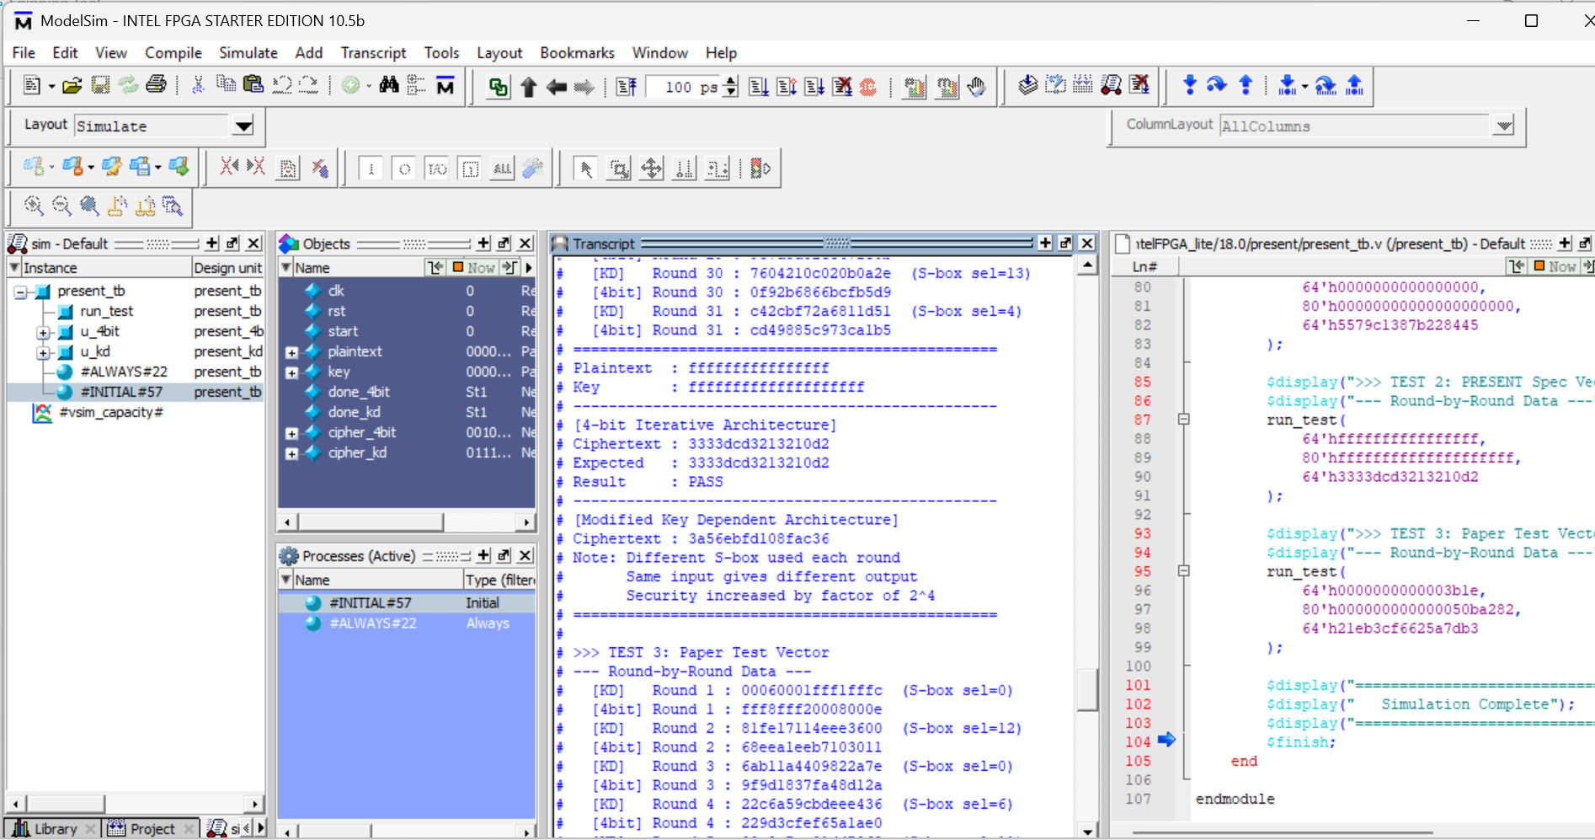
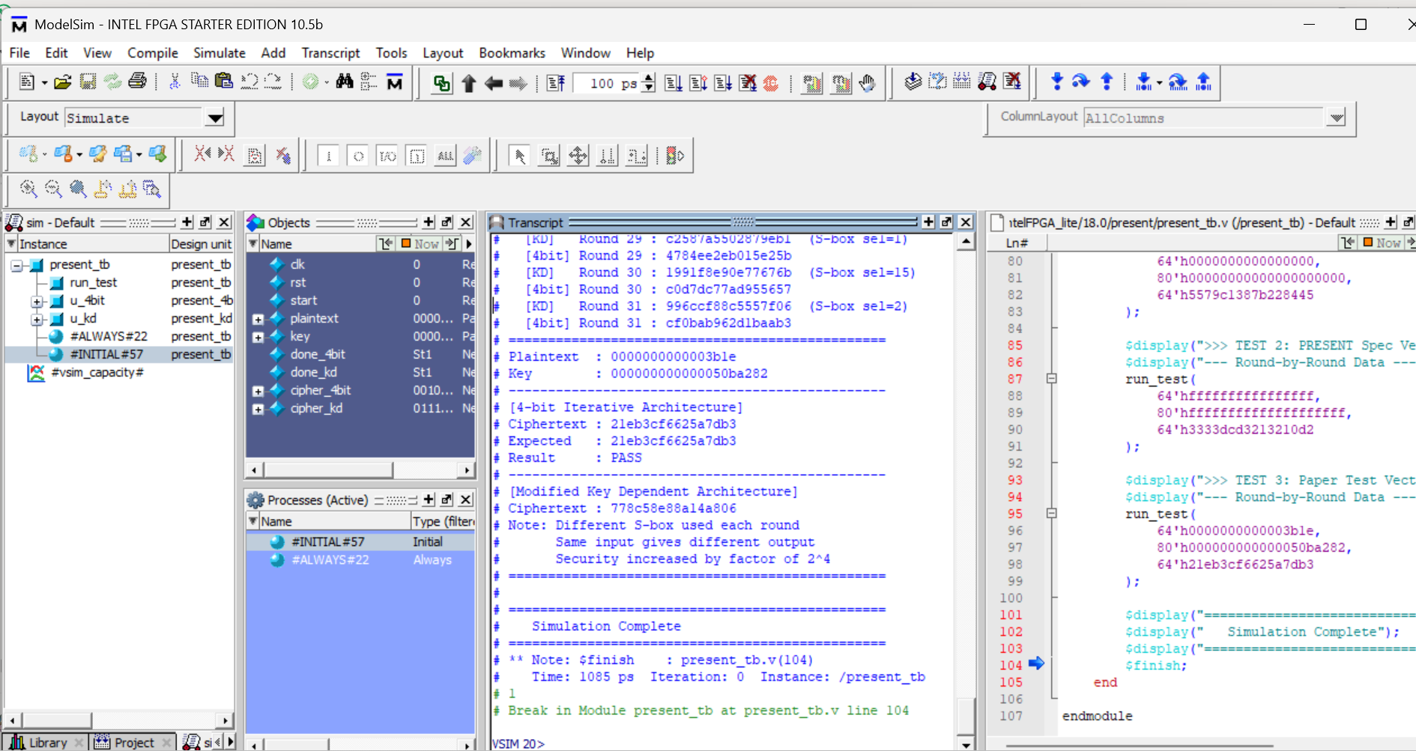
ModelSim Transcript
Round-by-round output — S-box selector visible in Key Dependent architecture
Test 2 — Spec Vector 4
KD sel changes:
0 → 13 → 14 → 8...
per round
Test 3 — Paper Vector
4-bit: 21eb3cf6... PASS ✓
KD: 778c58e8... (different)
Simulation Complete
Notes:
Point to the PASS lines and show the changing S-box selectors (sel=0, sel=13, sel=14...) in the KD architecture output.

Slide 11
Conclusion
Correct Implementation
✓
4-bit iterative architecture verified against ISO/IEC PRESENT specification — all 3 test vectors PASS in ModelSim
Area Efficient
⬡
Only 320 logic elements on Intel MAX 10 (< 1%) — 4-bit MUX design reduces area vs loop-based and 8-bit architectures
38% Faster
⚡
33 clock cycles to encrypt vs paper's 51 cycles — parallel load eliminates serial loading overhead
Security Improved
🔒
Key Dependent architecture with 16 S-boxes — same input gives different output — 2⁴ stronger vs cryptanalysis attacks
Notes:
Close with: PRESENT is standardized for IoT. We verified it, made it faster, and demonstrated the security improvement of the Key Dependent architecture. Thank the reviewers.

